Slide 1
Civil Procedure
Class 15

Slide 2
Agenda
Recap
Trial by Jury
Takeaways

Slide 3
I. Recap

Slide 4
Key Takeaways for default and Dismissal
55, if party fails to plead or defend, default judgment
54(c), default is limited to the relief requested in pleadings
55(c), 60(b), mechanisms to grant relief from judgment
41(a), voluntary dismissal (i) before Answer or SJ motion, (ii) with other party’s stipulation, or (iii) by court order
41(b), if plaintiff fails to prosecute, involuntary dismissal

Slide 5
Summary Judgment—Steps in the Analysis
Identify the relevant substantive law, and identify what each party would need to prove at trial to win under that law
Identify what evidence each party can put forward
View that evidence in the light most favorable to the non-moving party
Ask whether a reasonable jury could, based on that evidence, decide for the non-moving party

Slide 6
II. Trial by jury

Slide 7
Constitutional Right to a Jury trial
Seventh Amendment: “In Suits at common law, where the value in controversy shall exceed twenty dollars, the right of trial by jury shall be preserved.”
This does not apply to suits in equity
So the question is: which suits are equitable, and which are legal?

Slide 8
Jury Trial under the FRCP
38(b), if the Constitution or a statute gives a right to jury trial, can demand jury trial by writing within 14 days of last pleading
38(d), failure to serve demand waives right to jury trial
38(d), if demand is made, can only be withdrawn with other party’s consent
39(b), if no demand is made, case is tried by the court

Slide 9
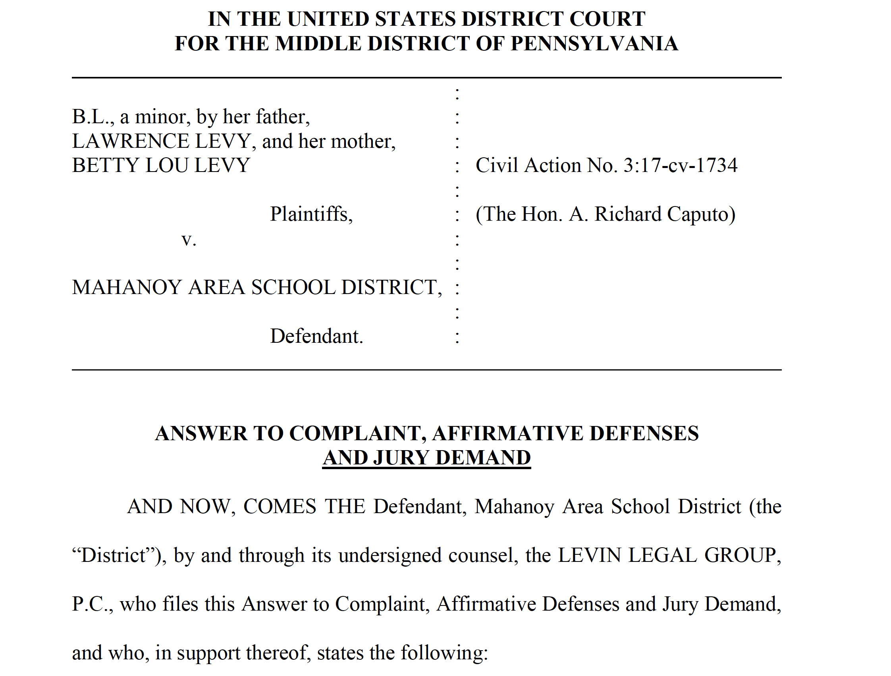
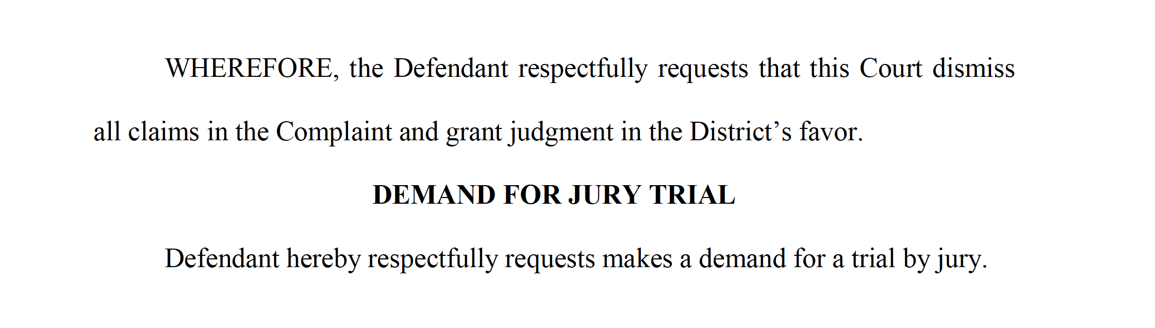

Slide 10
does jury right apply to new causes of action?
Curtis:
Jury trial right applies to:
  The right as it existed in 1791
  Also to common-law causes of action from after 1791
  And applies to “statutory rights,” if the statute creates “legal rights and remedies”

Slide 11
What are “legal rights and remedies”?
Curtis and Chauffeurs:
Test for “legal rights” is:
  Analogous to actions recognized at common law, and
  Relief sought is money damages (not equitable relief like an injunction)

Slide 12
Jury Selection
6-person juries are sufficient for jury trial right (Colgrove)
Rule 48(a), “a jury must begin with at least 6 and no more than 12 members”
48(b), verdict must be unanimous, by at least a 6-person jury, unless “parties stipulate otherwise”

Slide 13
Jury Selection
During voir dire, examine potential jurors in the jury pool:
  47(a), attorneys or the court examine prospective jurors
  47(c), can excuse “for good cause”
  Also 3 peremptory challenges, per 47(b) and 28 U.S.C. § 1870
  The Equal Protection Clause of the Constitution prohibits using peremptory strikes for racial or gender discrimination (Edmonson and J.E.B.), applies to both state and federal courts

Slide 14
III. Takeaways

Slide 15
Key Takeaways for jury trial
Seventh Amendment guarantees jury trial in civil cases, in federal court, for common law causes of action
For new causes of action since 1791:
  Was there an analogous action at common law in 1791?
  Is the relief sought legal, like money damages, rather than equitable, like an injunction? (Curtis; Chauffeurs)

Slide 16
Key Takeaways for jury trial
38(b), can demand jury trial by writing within 14 days of last pleading
38(d), if don’t properly demand, jury trial right is waived
39(b), if no proper demand, bench trial by the court
47, examine jurors, can excuse for “good cause,” plus 3 peremptory challenges; can’t use peremptory challenge for discriminatory purpose
48, need unanimous verdict by at least 6-person jury (6-person civil jury is ok per Colgrove)

